Slide 1

MALAVIYA NATIONAL INSTITUTE OF TECHNOLOGY JAIPUR CENTRE FOR ENERGY AND ENVIRONMENT RET 615 SEMINAR End Term Examination – 13.12.2021
Impact Analysis of Short Term Power Procurement Planning for Renewable Energy rich DISCOMs
Presented by
Bala Ganesh K
2020PCV5316
Supervisor
Dr. Parul Mathuria
Assistant Professor

Slide 2

CONTENTS
Significance
Indian DISCOMs Overview
Future Scope
Impact Analysis - Methodology
RE Integration & Long Term PPAs
References
Indian Power Sector Overview
Short Term Procurement - Market Mechanisms
Results and Discussion
Power Procurement – Indian Scenario
2

Slide 3
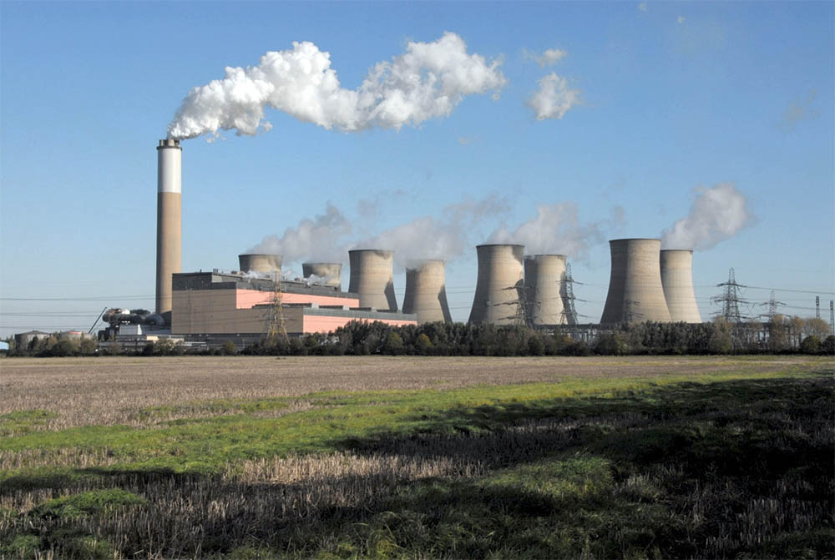

SIGNIFICANCE
POLLUTION
GLOBAL WARMING
EXHAUSTIBLE FUELS
CAPACITY ADDITION
SOCIO - ECONOMIC
POLICY DECISIONS
^{[1], [5], [10]}
GRID SCALE
CAPACITY UTILIZATION
UNCERTAIN DEMAND
INEXHAUSTIBLE
CLEAN
NO COST FUEL
MARKET MECHANISMS
RISK OF UNCERTAIN PRICES
DISCOM SPECIFIC
^{[10], [12], [16]}
INTERMITTENT
GEO - AVAILABILITY
INTEGRATION
3

Slide 4
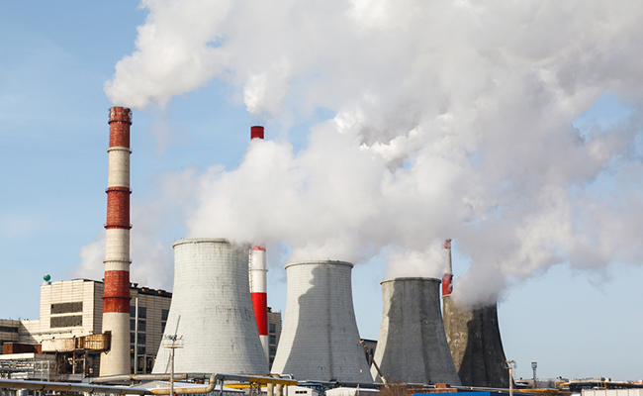
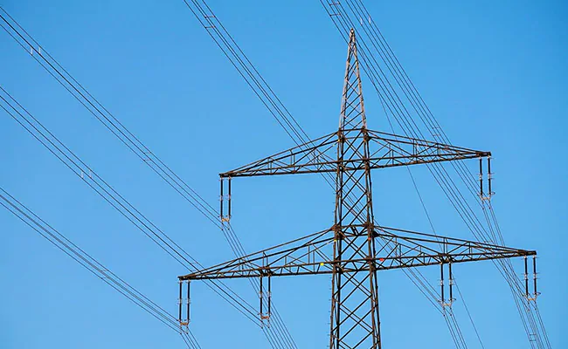
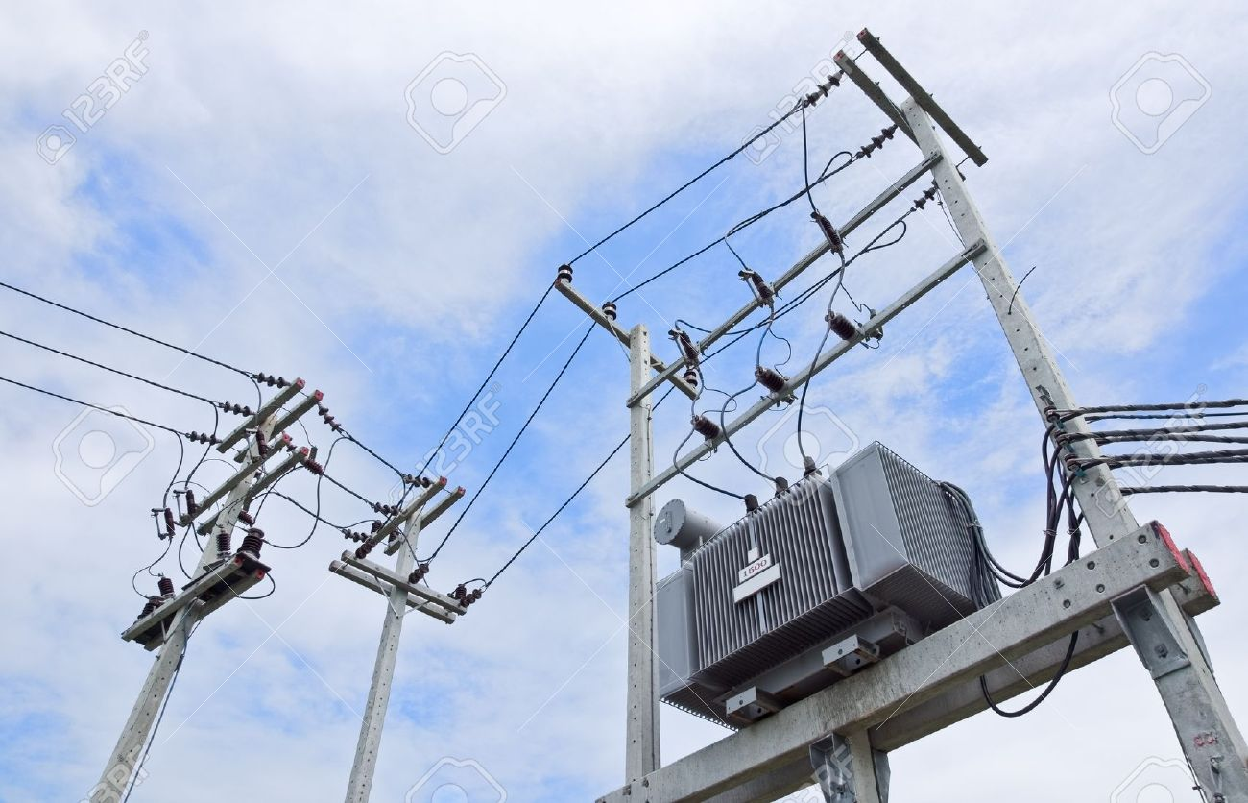
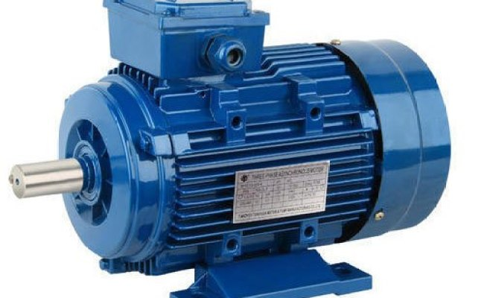



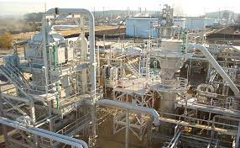



INDIAN POWER SECTOR OVERVIEW ^{[6], [19]}
GOVERNMENT & REGULATORS
GENERATING COMPANIES
TRANSMISSION COMPANIES
DISTRIBUTION COMPANIES
CONSUMER/LOAD
Central
State
Private (CPP/IPP)
Direct sale
PPAs with Discoms
Market sale
Day Ahead Market
Open Access for large consumers
Term Ahead Market
Real Time Market
Transmission capacity & allocation priority
Transmission charges & waive off for RES
Green corridors for RES generation evacuation
Own Generation
Purchase and Sale
From Discoms
Open Access
Short Term Markets
Roof Top Solar PV
Reliability & Quality
24*7 Power for all
RPO
Cost effective power
4

Slide 5
INDIAN DISCOMs OVERVIEW
FINANCIAL ASPECTS [7], [14]
Power Purchase Agreements [1, 25]
Long term (12-25 years)
Medium term (1-12 years)
Market based Power Purchase [8, 16]
Day Ahead Market
Green - DAM
Real Time Market
Short term (less than 1 year)
REC Market
ESCERTS Market
Term Ahead Market
Green - TAM
Very Short Term (Intra day)
High Subsidies without financial back up from State Govt.
Non Liquidation of Regulatory Assets
High Aggregate Technical and Commercial Loss
Customers opting Open Access & Behind The Meter generation
Generation cost
Landed Cost (Evacuation)
ARR for DISCOMs
Consumer bill
Levelized Cost Of Electricity
Aggregate Revenue Requirement (ARR)
Per unit cost of electricity
5

Slide 6
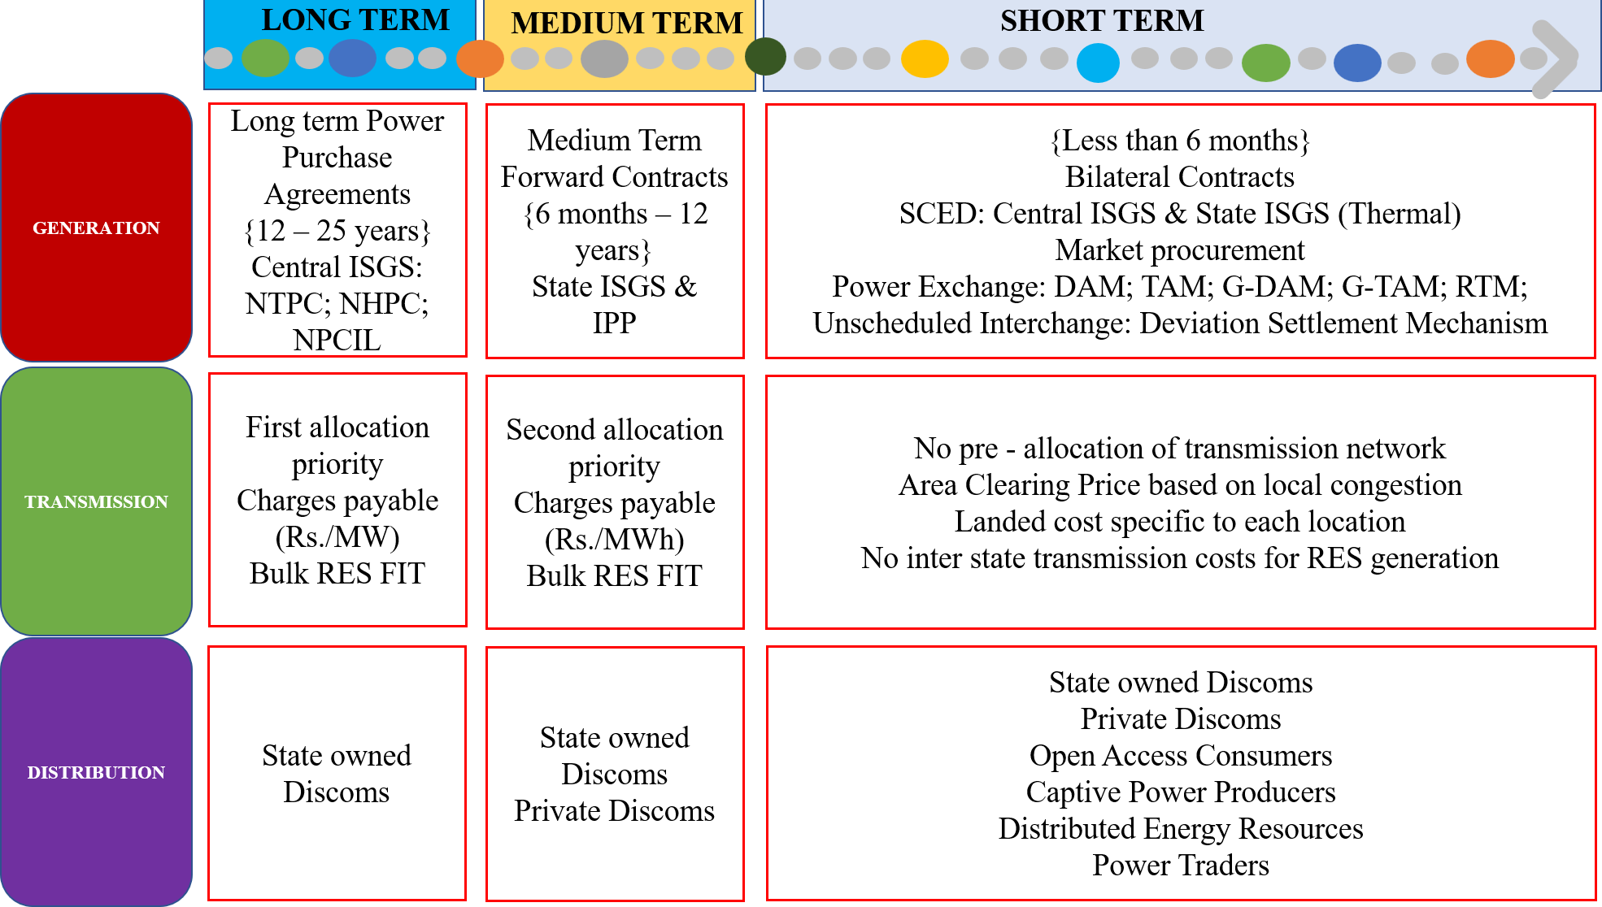
POWER PROCUREMENT – INDIAN SCENARIO [6], [8], [10], [14], [18], [19]
6

Slide 7
RENEWABLE ENERGY INTEGRATION
WIND ENERGY
SOLAR ENERGY
HYDRO ENERGY
[5], [10], [11], [12]
IMPACTS
[5], [10], [11], [12]
Demand variation
RES Integration
Optimum generation mix
Reduce gap between ACS-ARR
Consumer Financial benefits
Transmission capacity addition
FACTORS
[5], [10], [11], [12]
Load profile & load duration profile
Existing Long term & medium term contracts
Intra state transmission network
Own generation
Energy Market Contracts
Share of RES (FIT contracts & RPO)
7

Slide 8
RENEWABLE ENERGY INTEGRATION & LONG TERM PPAs
TAMIL NADU - RENEWABLE GENERATION ESTIMATION [2], [17], [20]
Installed RE Capacity - April 2021
Wind 9628 MW
Bio power and Cogeneration 1019 MW
Solar Rooftop 325 MW
Small Hydel
123 MW
Solar Ground Mounted 4150 MW
Large Hydro 2178 MW
Source: www.renewablesindia.in – CEA/CEEW/CEF and www.renewableninja.com
Source: www.renewablesindia.in – CEA/CEEW/CEF
POWER PROCUREMENT EVOLUTION [2], [13], [14]
ISGS (Central Thermal, Central Nuclear & Other Thermal)
Renewable (Wind, Biomass, Bagasse & Solar) & Traders
Market Procurement (Bilateral Contracts, DAM, RTM)
State (Thermal, Hydro & Gas) & Long Term PPAs
Behind the Meter Generation (PROSUMERS)
8

Slide 9


SHORT TERM PROCUREMENT - MARKET MECHANISMS
MARKET PROCUREMENT [5], [8], [16]
INDIAN ELECTRICITY MARKET [5], [8], [16]
DEMAND FORECASTING (TIME SLOT)
IDENTIFICATION OF SOURCES/SUPPLIERS
TECHNICAL & FINANCIAL CONSIDERATIONS
NEGOTIATION OF T&C : ESTABLISHMENT OF CONTRACTS
EVALUATION OF CONTRACTS AND RECEIVE SUPPLY
BILATERAL CONTRACTS
EXCHANGES
SECURITY CONSTRAINED ECONOMIC DISPATCH
Day Ahead Market
Term Ahead Market
Real Time Market
Renewable Energy Certificates Market
Green Day Ahead Market
Green Term Ahead Market
9

Slide 10
IMPACT ANALYSIS - METHODOLOGY
Demand Data & Renewable Generation → Input to model
GAMS Model → Cost optimization & Risk Analysis
API Software → GUI development (FUTURE SCOPE)
Mathematical Model → Constraints & Power Balance
Input from MS Excel
Conventional Generation details
Diurnal load demand
PV Generation data
Wind Generation data
Hydro Generation data
Market Details
{DAM RTM REC}
SIMPLE COST OPTIMIZATION
Preliminary Economic Dispatch
Economic Dispatch with PV & Wind
COST OPTIMIZATION WITH MARKET INTEGRATION
Market procurement (DAM, RTM, G-DAM)
DSM & RPO Constraints
Risk analysis of Uncertainty in MCP
10

Slide 11
MATHEMATICAL MODEL
Objective Function
Final cost, C_{FINAL} = C_{TOTAL} + [α*Risk]
where,
C_{FINAL} → Total cost incurred to DISCOM at various levels of risk taking scenario with market clearing price uncertainty
C_{TOTAL} → Cost of procuring power at maximum risk of market clearing price uncertainty
Risk → Uncertainty in market clearing prices of DAM, RTM and DSM price based on real time grid frequency
α →Risk weighing factor, which when increases indicates lesser willingness to take risk
Procurement Cost modelling
Total cost, C_{TOTAL} = C_{C} + C_{H} + C_{LS} + C_{DSM} + C_{PX} + C_{DAM} + C_{RTM} + C_{G_DAM} + C_{S_REC} + C_{NS_REC}
where,
C_{C} → Conventional generation cost C_{DAM} → Cost of procurement from DAM
C_{H} → Hydro generation cost C_{RTM} → Cost of procurement from RTM
C_{LS} → Penalty cost for Load Shedding C_{G_DAM} → Cost of procurement from G_DAM
C_{DSM} → Cost for deviation from schedule C_{S_REC} → Cost of procuring Solar REC
C_{PX} → TAM contracts procurement cost C_{NS_REC} → Cost of procuring Non Solar REC
11

Slide 12
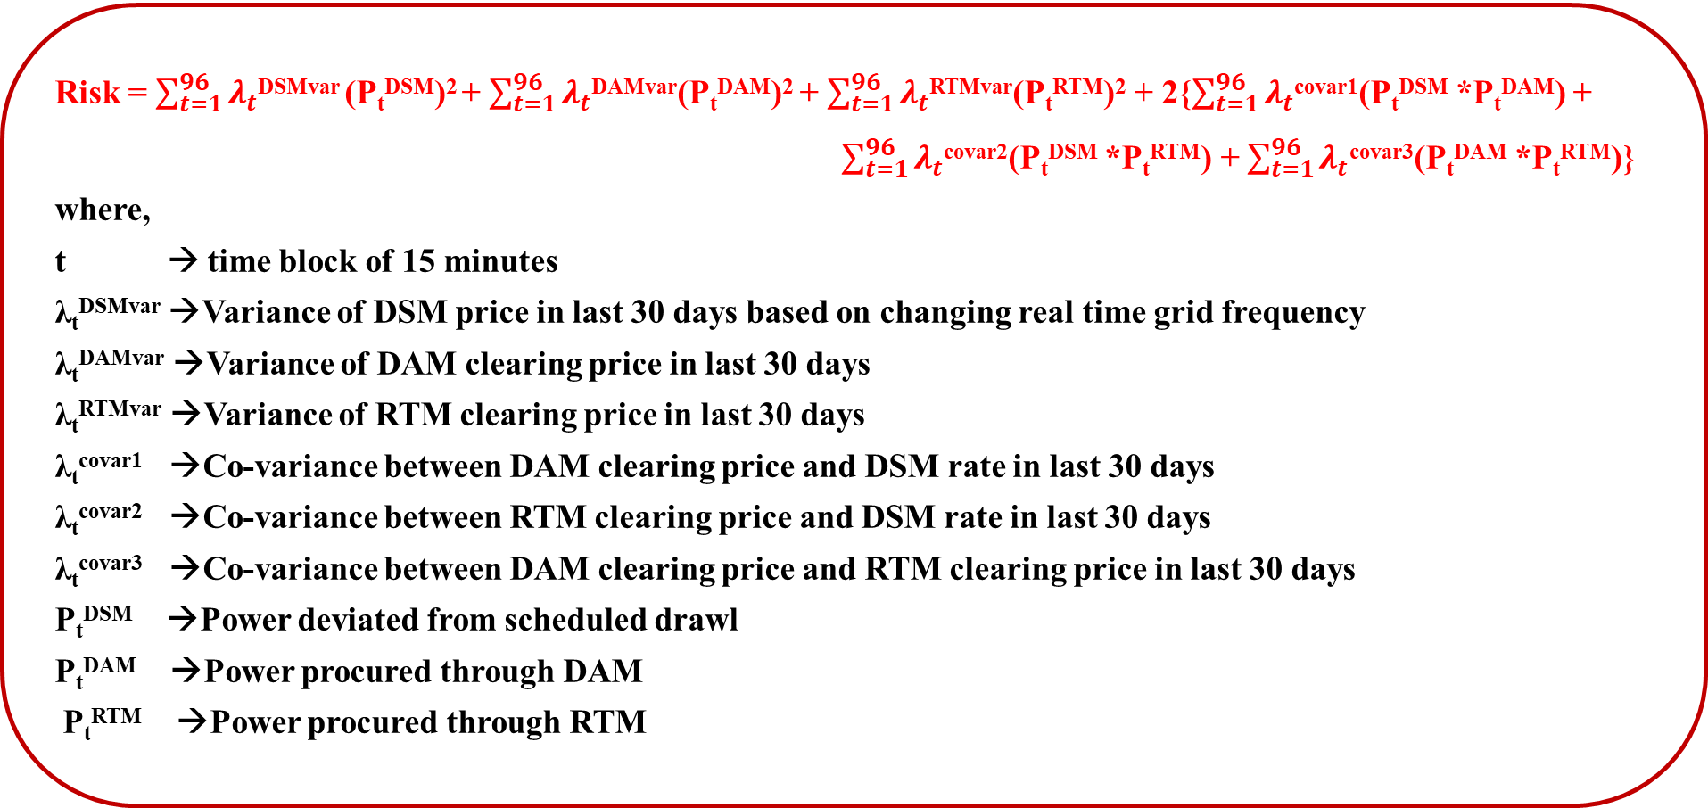
MATHEMATICAL MODEL
Risk modelling of uncertainties in price [27]
Risk = $\sum_{t=1}^{96}{λ_{t}}$^{DSMvar} (P_{t}^{DSM})² + $\sum_{t=1}^{96}{λ_{t}}$^{DAMvar}(P_{t}^{DAM})² + $\sum_{t=1}^{96}{λ_{t}}$^{RTMvar}(P_{t}^{RTM})² + 2{$\sum_{t=1}^{96}{λ_{t}}$^{covar1}(P_{t}^{DSM} *P_{t}^{DAM}) +
$\sum_{t=1}^{96}{λ_{t}}$^{covar2}(P_{t}^{DSM} *P_{t}^{RTM}) + $\sum_{t=1}^{96}{λ_{t}}$^{covar3}(P_{t}^{DAM} *P_{t}^{RTM})}
where,
t → time block of 15 minutes
λ_{t}^{DSMvar} →Variance of DSM price in last 30 days based on changing real time grid frequency
λ_{t}^{DAMvar} →Variance of DAM clearing price in last 30 days
λ_{t}^{RTMvar} →Variance of RTM clearing price in last 30 days
λ_{t}^{covar1} →Co-variance between DAM clearing price and DSM rate in last 30 days
λ_{t}^{covar2} →Co-variance between RTM clearing price and DSM rate in last 30 days
λ_{t}^{covar3} →Co-variance between DAM clearing price and RTM clearing price in last 30 days
P_{t}^{DSM} →Power deviated from scheduled drawl
P_{t}^{DAM} →Power procured through DAM
P_{t}^{RTM} →Power procured through RTM
12

Slide 13
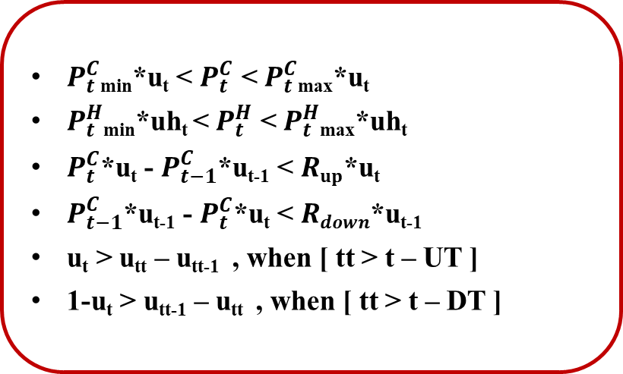
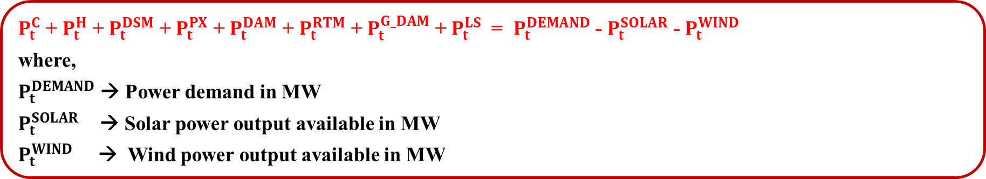
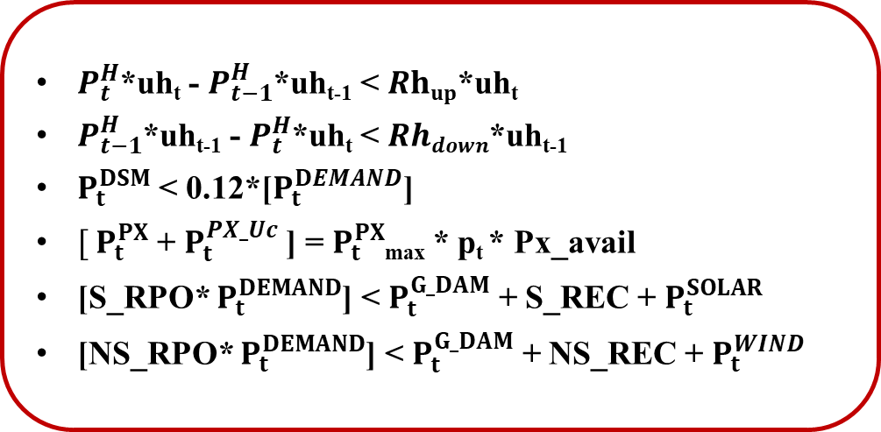
MATHEMATICAL MODEL
Power balance
$P_{t}^{C}$ + $P_{t}^{H}$ + $P_{t}^{DSM}$ + $P_{t}^{PX}$ + $P_{t}^{DAM}$ + $P_{t}^{RTM}$ + $P_{t}^{G_DAM}$ + $P_{t}^{LS}$ = $P_{t}^{DEMAND}$ - $P_{t}^{SOLAR}$ - $P_{t}^{WIND}$
where,
$P_{t}^{DEMAND}$ → Power demand in MW
$P_{t}^{SOLAR}$ → Solar power output available in MW
$P_{t}^{WIND}$ → Wind power output available in MW
Constraints
$P_{t}^{C}$_{min}*u_{t} < $P_{t}^{C}$ < $P_{t}^{C}$_{max}*u_{t}
$P_{t}^{H}$_{min}*uh_{t} < $P_{t}^{H}$ < $P_{t}^{H}$_{max}*uh_{t}
$P_{t}^{C}$*u_{t} - $P_{t−1}^{C}$*u_{t-1} < $Rup$*u_{t}
$P_{t−1}^{C}$*u_{t-1} - $P_{t}^{C}$*u_{t} < $Rdown$*u_{t-1}
u_{t} > u_{tt} – u_{tt-1} , when [ tt > t – UT ]
1-u_{t} > u_{tt-1} – u_{tt} , when [ tt > t – DT ]
$P_{t}^{H}$*uh_{t} - $P_{t−1}^{H}$*uh_{t-1} < $Rhup$*uh_{t}
$P_{t−1}^{H}$*uh_{t-1} - $P_{t}^{H}$*uh_{t} < $Rhdown$*uh_{t-1}
$P_{t}^{DSM}$ < 0.12*[$P_{t}^{DEMAND}$]
$[ P_{t}^{PX}$ + $P_{t}^{PX_Uc}$] = $P_{t}^{PX}$_{max} * p_{t} * Px_avail
[S_RPO* $P_{t}^{DEMAND}$] < $P_{t}^{G_DAM}$ + S_REC + $P_{t}^{SOLAR}$
[NS_RPO* $P_{t}^{DEMAND}$] < $P_{t}^{G_DAM}$ + NS_REC + $P_{t}^{WIND}$
13

Slide 14
RESULTS AND DISCUSSION
TAMIL NADU – HIGH RE SCENARIO
RAJASTHAN – HIGH RE SCENARIO
WITH G_DAM – LOW RE SCENARIO
WITHOUT G_DAM – HIGH RE SCENARIO
14

Slide 15
RESULTS AND DISCUSSION
TAMIL NADU – HIGH RE SCENARIO – LOW RISK
TAMIL NADU – HIGH RE SCENARIO – HIGH RISK
DSM
STM
RENEWABLES
CONTRACTS
NUCLEAR
THERMAL
15

Slide 16
RESULTS AND DISCUSSION
TAMIL NADU – LOW RE SCENARIO
TAMIL NADU – HIGH RE SCENARIO
TAMIL NADU – LOW RE SCENARIO
16

Slide 17
RESULTS AND DISCUSSION
RAJASTHAN – LOW RE SCENARIO
RAJASTHAN – HIGH RE SCENARIO
17

Slide 18
RESULTS AND DISCUSSION - COMPARISON
18

Slide 19
RESULTS AND DISCUSSION – COMPARISON & IMPLICATIONS
Long Term Impacts
Operational reliability
Inertia availability for frequency response
Long term policy framework
Procurement Portfolio design
Short Term Impacts
Real power balancing
Increased Reserve requirement
RE curtailment minimization
Scheduling of conventional power plants
TECHNICAL
Reserve Requirements (Frequency & Voltage)
Ramping Requirements & Transmission Congestion
FINANCIAL
RPO, RGO & DSM
Tariff Philosophy, Green Energy Markets
POLICY AND REGULATION
INFRASTRUCTURE
Uncertainty of Market Clearing Price
ACS – ARR of DISCOMs & Impact of OA consumers
Capacity Addition Planning & Storage Requirements
Metering & ICT Requirements
19

Slide 20
RESULTS AND DISCUSSION – COST COMPARISON
PROCUREMENT COST SUMMARY |  |  | PROCUREMENT COST SUMMARY
State | RE availability | Risk | Procurement Cost per day (Crores) | Annual Procurement Cost (Crores)
Tamil Nadu | High | High | 165.70 | 72,462.40
 | High | Low | 175.70 | 76,118.30
 | Low | High | 176.93 | 77,857.70
 | Low | Low | 183.20 | 79,060.20
Rajasthan | High | - | 108.62 | 57,957.88
 | Low | - | 142.08 | 70,407.56
20

Slide 21
FUTURE SCOPE
POWER PROCUREMENT OF STATE DISCOMS
TAMIL NADU
(HIGH WIND)
UTTAR PRADESH
( HIGH MARKET PROCUREMENT)
NEW DELHI
(HIGH DEMAND WITH VERY LOW RES)
RAJASTHAN
(HIGH SOLAR)
COMPARATIVE ANALYSIS OF STATE DISCOMS UNDER VARYING QUANTUM OF RE INTEGRATION
RES AVAILABILITY
RISK TAKEN BY DISCOM
High
Average
Low
No
Low
High
FULL SCALE TOOL: API Software → GUI development
PUBLICATIONS
INTERNATIONAL CONFERENCE - COMMUNICATED
B. Ganesh, R. Vijay, P. Mathuria, R. Bhakar, “Short Term Power Procurement with Market Uncertainties for RE rich Indian Discom” communicated in IEEE Power and Energy Society – General Meeting, 2022.
21

Slide 22

REFERENCES
TYPE | S.No. | TITLE OF DOCUMENT | AGENCY | YEAR
REPORTS | 1 | 19th Electric Power Survey of India | EPS Committee | 2017
 | 2 | Pathways for TN’s Power sector 2020-2030 | NREL | 2020
 | 3 | Long Term Electricity Demand Forecasting | CEA | 2019
 | 4 | Daily Grid details | TANTRANSCO | 2021
 | 5 | India Energy Policy Review 2020 | IEA | 2020
 | 6 | Overview of Power Sector | PRS | 2019
 | 7 | Turning around the power distribution sector – Learnings & Practices from reforms | NITI Aayog | 2021
 | 8 | Monthly Report on Short Term transactions of electricity in India | CERC | 2021
 | 9 | DSM & related Regulations | CERC | 2021
 | 10 | Renewables Integration in India | NITI Aayog & IEA | 2021
 | 11 | Report of technical committee on study of optimal location various types of ESS to facilitate integration of RES and associated issues | CEA | 2017
 | 12 | Rethinking DISCOM Resource Planning in RE rich environment | USAID - MNRE | 2019
 | 13 | Power for All – Tamil Nadu | Govt. of India & TN | 2016
 | 14 | Determination of tariff for Generation & Distribution – Tamil Nadu | TNERC | 2017
 | 15 | Load Forecasting and Power Procurement Planning for Uttar Pradesh | IIT Kanpur | 2019
22

Slide 23
REFERENCES
TYPE | S.No. | TITLE OF DOCUMENT | AGENCY | YEAR
WEBSITES | 16 | INDIAN ENERGY EXCHANGE https://www.iexindia.com/ | IEX, SEBI | 2021
 | 17 | MERIT ORDER DISPATCH https://www.meritindia.in/ | MoP, Govt. of India
 | 18 | CENTRAL ELECTRICITY REGULATORY COMMISSION https://cercind.gov.in/ | CERC | -
 | 19 | MINISTRY OF POWER https://powermin.gov.in/ | MoP, Govt. of India
 | 20 | RENEWABLES.NINJA https://www.renewables.ninja/ | Renewable Ninja
 | 21 | SOUTHERN REGIONAL LOAD DESPATCH CENTRE https://srldc.in/ | POSOCO
 | 22 | MINISTRY OF NEW AND RENEWABLE ENERGY https://mnre.gov.in/ | MNRE, Govt. of India
 | 23 | WESTERN REGIONAL LOAD DESPATCH CENTRE https://wrldc.in/ | POSOCO
 | 24 | ENERGY ANALYTICS LAB https://eal.iitk.ac.in/ | IIT Kanpur
PAPERS | 25 | Long Term electricity procurement portfolio optimization | EPSR, Elsevier | 2021
 | 26 | Discussion Paper on designing market for tertiary ancillary services in India | CERC | 2018
 | 27 | Risk Constrained Short Term Electricity Procurement for OA Consumer in India | NPSR, IEEE | 2016
23

Slide 24
REFERENCES
[1] “India 2020 – Energy policy review,” IEA., Paris., France., Tech. Rep., Jan. 2020
[2] “Renewables integration in India,” NITI Aayog., New Delhi., India., IEA., Paris., France., Tech. Rep., Apr. 2021
[3] “Monthly report on short-term transactions of electricity in India,” Economics Division CERC., New Delhi., India.,
Tech. Rep., Mar. 2021
[4] P. Regy, R. Sarwal, C. Stranger, G. Fitzgerald, J. Ningthoujam, A. Gupta, N. Singh., “Turning around the power
distribution sector - learnings and best practices from reforms,” NITI Aayog., New Delhi., India., RMI India., New Delhi.,
India., Tech. Rep., Aug. 2021
[5] “Report of the technical committee on study of optimal location of various types of balancing energy sources/energy
storage devices to facilitate grid integration of renewable energy sources and associated issues,” CEA., New Delhi., India.,
Tech. Rep., Dec. 2017
[6] Central Electricity Regulatory Commission., accessed: 02 Nov. 2021 < https://cercind.gov.in/>
[7] C.K Simoglou, P.N Biskas, I.G Marneris, C.G Roumkos, “ Long-term electricity procurement portfolio optimization, ”
Electric Power Systems Research, vol. 202, Jan. 2021
[8] “19th Electric power survey of India, ” CEA., New Delhi., India., Tech. Rep., 2017
[9] Ministry of Power., <https://powermin.gov.in/>
[10] MERIT Order Dispatch of Electricity for Rejuvenation of Income and Transparency., <https://meritindia.in/>
[11] “Long term electricity demand forecasting, ” CEA., New Delhi., India., Tech. Rep., 2019
[12] “Rethinking DISCOM resource planning in renewable energy rich environment, ” USAID., USA., MNRE., India., 2019
24

Slide 25
REFERENCES
[13] “Discussion paper on designing market for tertiary ancillary services in India, ” CERC., New Delhi., 2018
[14] A. Rose, I. Chernyakhovskiy, D. Palchak, M. Schwarz, S. Koebrich, M. Joshi., “Pathways for Tamil Nadu's electric power
sector: 2020 – 2030, ” NREL., Tech. Rep. Jan. 2021
[15] “Daily state load dispatch centre report, ” TANTRANSCO., Chennai, India
[16] “Determination of tariff for generation and distribution, ” TNERC., Chennai, India., Order in T.P. No.1of 2017
[17] “Power for All – TN document, ” A joint venture of Govt. of India and Govt. of TN., 2016
[18] A. Singh., “Load forecasting & power procurement planning for UP, ” IIT Kanpur., India
[19] P. Sharma, U. Brighu, R. Bhakar, P. Mathuria., “ Risk Constrained Short Term Electricity Procurement for Open Access
Consumer in India, ” IEEE., 2016
[20] P. Mishra, “Overview of the power sector,” PRS., Sept. 2019
[21] Indian Energy Exchange., accessed: 02 Nov. 2021 <https://www.iexindia.com/>
[22] Renewables.Ninja., accessed: 02 Nov. 2021 <https://www.renewables.ninja/>
[23] Southern Regional Load Despatch Centre., accessed: 02 Nov. 2021 <https://srldc.in/>
[24] Ministry of New and Renewable Energy., accessed: 02 Nov. 2021 <https://mnre.gov.in/>
[25] Western Regional Load Despatch Centre., accessed: 02 Nov. 2021 <https://wrldc.in/>
[26] Energy Analytics Lab., accessed: 02 Nov. 2021 < https://eal.iitk.ac.in/>
25

Slide 26


